Slide 1
GRIEF & BEAUTY Robert Arnold Johnson, MD robertarnoldjohnson@gmail.com
WHY BOTH ARE GOOD FOR US
“Casta Diva,” from Norma, Vincenzo Bellini, 1831
Beethoven, Violin Concerto, 2nd movement, 1806
Notes:
[Begin before the hour, play while folks get seated. STOP THE MUSIC TO BEGIN THE SESION.]
(RAJ) “This session may seem strange as it proceeds, because I, the speaker, will hardly speak. I will be more like a DJ, playing music and showing pictures, plus reading one poem. There will be text on the slides for you to read, which I have authored, but not a whole lot of it, overall. The session is designed to be an experience more than a lesson, more a concert than a lecture. So, as you would for a concert, silence your mobile phones. Also, since getting the most out of it will require some concentration, please don’t chat with others until we’re finished. Save questions, maybe make notes about them to mark your thoughts, until the end. You will sometimes be impatient, want things to move faster. Try to slow your mind to the pace of the presentation, because that’s an aspect of how it, and GRIEF itself, works. At other times, you will be annoyed that I have stopped a piece of music before its end. I, too, would like to hear each piece all the way through. Yet I believe my purpose, to give you something, a hint, of how many ways beauty and grief keep company, justifies my decisions.”

Slide 2
WHAT IS GRIEF? Rachmaninov, Romance/Ballade (transcription for piano/cello from an unidentified original), c.1890
GRIEF is calm sadness. It is always about loss (absolute or relative). It draws us to the person bearing it, we want to witness and to help. Eyes are wet perhaps, maybe trickle, but they are not heavily lachrymose. It does not torment. Our job as witnesses is just to be a loving presence; we need say nothing at all. In this way GRIEF is very pro-social, highly adaptive: it asks nothing of its witness except empathic silence, which it draws out of him or her wordlessly. Just such a witness is likely to be the most steadfast helper, if and when needed.
Notes:
. (2 min) [Rachmaninov, Romance/Ballade—transcribed, probably, from ??; this recording, Marina Tarasova, cellist, mistakenly says Opus 1. No. 5]

Slide 3
GRIEF AND SERENITY SERENITY = calm not sad. GRIEF= calm and sad Raphael, “La Madonna del Granduca,” 1505
Notes:
(1/2 min) [Raphael, “La Madonna del Granduca,” 1505]

Slide 4
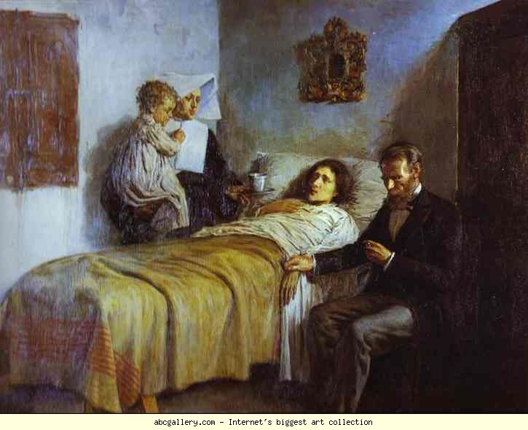
WHAT IS GRIEF?
GRIEF is calm sadness. Pablo Picasso, “Science and Charity,” 1897
Notes:
(1/2 min) [Pablo Picasso, “Science and Charity,” 1897]

Slide 5
WHAT ARE THE INTEGRATED PRO-SOCIAL AFFECTS?
Grief. Joy (Play). Love.
Dvorak: Cello Concerto, 2nd movement, 1895.
Notes:
(2 min) [Dvorak, Cello Concerto, 2nd movement, 1895] “I am not alone, of course, in identifying the pro-social power of grief. I will quote from a very recent article in The New Yorker (04/11/2016), written by Calvin Tomkins, an article about a currently very hot Icelandic artist named Ragnar Kjartansson. Kjartansson, a performance artist, has composed a piece in which a song ‘Sorrow,’ by a rock band called the National, is sung over and over for six hours. The band’s lead singer had this to say. ‘I think we all went into a bit of a trance. During the last hour, I started thinking about my daughter and completely choked up. The others took over the singing, and then the audience started—the whole room was singing. We were all in the same exhausted, milky space.’”

Slide 6
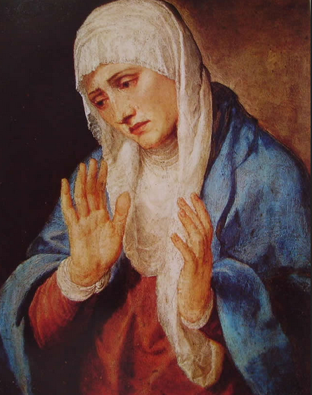
HOW IS GRIEF PRO-SOCIAL?
WE WANT TO HELP
Titian, “L’Addolorata A Mani Aperte,” 1554
Notes:
(1/2 min) [Titian, “L’Addolorata A Mani Aperte,” Madrid, Prado, 1554]

Slide 7
“Barbara Allen,” traditional Scottish ballad, c. 1666 (1st mention in print) is said to be the most widely collected song in English, period. “Art is news that stays news” (Ezra Pound, early 20th century American poet).
Notes:
(2 min) [Barbara Allen]

Slide 8
CAN YOU DATE THESE? LOSSES IN A LIFE: THE EPOCH MATTERS ANGUISH (WOE) AND GRIEF ARE NOT THE SAME THING
1. lacrimarum valle (valley of tears)
2. “For ever the latter end of joy is woe.
God knows that worldly joy is soon ago.”
3. “Life’s a bitch, and then you die!”
Notes:
(2 min) “All 3 of these expressions claim that life is mainly about loss, the 3rd one does so tongue-in-cheek. The first is the Latin expression for “valley of tears” and is taken from the prayer, Salve Regina, composed in the 11th century or earlier—a lament on the tribulation of mortal life, at a time when median lifespan was about 30 years. Death of someone you knew was part of the everyday. The second is taken from Geoffrey Chaucer’s Canterbury Tales (The Knight’s Tale), written in 1393. Median lifespan had not changed from 300 years earlier, or, indeed, from that of Greek and Roman antiquity. The 3rd appears first in print in 1982 in the Washington Post (in the 90s it became a line in a rap song). Why can it be tongue-in-cheek? Because by 1982 median lifespan is 75 years.’

Slide 9
ART, UNIVERSALLY, AROUSES OUR SENSE OF THE ENIGMATIC GRIEF ITSELF IS ENIGMATIC, ALONE OR AS A SHADOW TO ANOTHER ENIGMA Enraptured gaze of Parvati, wife of the Hindu deity Shiva, 8th-century mural: Talagirishvara temple in Panamalai, Tamil Nadu, India.
Notes:
(The enraptured gaze of Parvati, wife of the Hindu deity Shiva, glows from an 8th-century mural, one of the glories of Indian art. The mural survives in Talagirishvara temple in Panamalai, in the southern state of Tamil Nadu.
(1/2 min) [Parviti, wife of Shiva, 8th century AD]

Slide 10
ART, UNIVERSALLY, AROUSES OUR SENSE OF THE ENIGMATIC GRIEF ITSELF IS ENIGMATIC, ALONE OR AS A SHADOW TO ANOTHER ENIGMA Ellsworth Kelly, “Green-Blue,” 1968
Notes:
(1/2 min) [Ellsworth Kelly, “Green-Blue”, 1968]

Slide 11
ART, UNIVERSALLY, AROUSES OUR SENSE OF THE ENIGMATIC GRIEF ITSELF IS ENIGMATIC, ALONE OR AS A SHADOW TO ANOTHER ENIGMA Great (Friday) Mosque of Herat (Afghanistan). Architect: Jalal al-Din Firuzshaw. Completed 1446.
Notes:
(1/2 min) [Friday Mosque, Herat, Afghanistan, 1446]

Slide 12
WHAT IS ENIGMA? Here, it’s to be thought of in a philosophical sense, as a contrast to a problem.
enigma and problem — each is a form of “surprise” within our experience
With contemplation, an enigma enlarges, deepens, becomes richer. Example: “health.”
With solution, a problem vanishes. Example: “illness.”
ALL OF US SOMETIMES, MANY OF US USUALLY OR ALWAYS, DENY THE ENIGMATIC IN FAVOR OF THE PROBLEMATIC—i.e., these days we do. We create unconscious fantasies of perfection: they are our solutions for enigma we’ve turned into problems. BUT If or when we suffer loss, are accused, become ill, a diagnosis is bestowed upon us—our unconscious “solution” is punctured → conscious anguish or unconscious avoidance (denial, dissociation).
Beethoven, 3rd Piano Concerto, 2nd movement, 1800
Notes:
(4 min) [Beethoven, 3rd Piano Concerto, 2nd movement, 1800]

Slide 13
“Jeannie with the Light Brown Hair,” Stephen Foster, 1854 (Here, loss is relative: love.) GRIEF HAS THREE POSSIBLE OUTCOMES Acceptance (Dawning) hope A combination of acceptance & hope
Notes:
(2 min) [Stephen Foster, ‘Jeannie with the Light Brown Hair,” 1854.]

Slide 14
“Shenandoah,” early 19th century, American/Canadian (Again, relative loss—longing for “home.”). GRIEF → ACCEPTANCE & (DAWNING) HOPE
Notes:
(2 min) [“Shenandoah,” early 19th century, American/Canadian]

Slide 15
“Don’t Think Twice, It’s All Right,” Bob Dylan, 1963 (Relative loss, here again a relationship) GRIEF → ACCEPTANCE
Notes:
(2 min) [“Don’t Think Twice, It’s All Right,” Bob Dylan, 1963]

Slide 16
GRIEF & BEAUTY WHY ARE BOTH GOOD FOR US?
THEY ARE ASPECTS OF THE SAME THING (ENIGMA): THEY UNIFY WITHIN AND WITHOUT.
The self-parts within us AND us to others without.
Aaron Copland, Sonata for violin, 2nd movement, 1943
Notes:
(1 ½ min) [Aaron Copland, Sonata for violin, 2nd movement, 1943]

Slide 17
HOPE: “DAWNING” V. “DAUNTING”
(DAWNING) HOPE RISES (OFTEN INTO GRIEF)—IT’S EFFORTLESS AND ENIGMATIC, A HAPPENING It is quiet optimism, targeted (on a topic of the mind) or diffused (a “posture” of the mind). Hope without expectation.
(DAUNTING) HOPE IS EFFORTFUL (CHEERLEADING), A FORM OF EXHORTATION—A SOLUTION TO A PROBLEM It’s most adaptive as an encouragement for another to accomplish something, or for a warrior. Hope with expectation.
But it has risk. It is often deployed unconsciously as a defense—a disavowal of GRIEF or disappointment, i.e., a form of fantasizing as a denial of the possibility of either.
Max Bruch, Kol Nidrei (a version for piano & cello), 1880
Notes:
(2 ½ min) [Max Bruch, Kol Nidrei (a version for piano & cello), 1880]

Slide 18
IN THIS POEM, IS BEAUTY, GRIEF, (DAWNING) HOPE, PLAY, OR ACCEPTANCE THE ENIGMA IN THE LEAD?
PROVISIONAL ETERNITY
A man and a woman lay in bed. “Just one more time,” said the man,
“Just one more time.” “Why do you keep saying that?” said the woman.
“Because I never want it to end,” said the man. “What don’t you want
to end,” said the woman. “This,” said the man, “this never wanting it
to end.”
Mark Strand (1934-2014)
The New Yorker, 06/13/2011
Notes:
“Grief, beauty, acceptance, (dawning) hope, play: we experience their relationships, their kinship as enigma, but how to put that into words? We may simply decide to remain silent, as Ludwig Wittgenstein, the Viennese philosopher, once advised, or we may speak metaphorically, as in ‘they are each a shadow of the other.’ All are strongly pro-social aspects of mental life. Biologically, recall that evolution keeps innovating on neural networks that are already in place.’ Play, for example, may begin in the animal chain as early as the ant.

Slide 19
FOR HUMANS PERSONALLY, PERHAPS THESE TWO ENIGMA LOOM ABOVE OTHERS
1. SELF-MATURITY: When have I (do I) become myself?
2. KNOWLEDGE OF DEATH: What should I do (make) with it?
If we turn these enigma into problems, which we are prone to do, we may, we usually do, “solve” them via unconscious fantasies of perfection, which puts them “out of mind.” WHAT ARE EXAMPLES?
“I’m a perfectly mature person, really”; “I’m in perfect health, and will remain so indefinitely.”
Miles Davis, Blue in Green, 1962
Notes:
(3 min) [Miles Davis, Blue in Green, 1962]

Slide 20
THE PERFECTION-FANTASY PUNCTURED: WHAT TO DO?
GRIEVE: treat the punctured fantasy as loss (relative) and perfection itself as enigmatic—the mature position. It’s realistic AND comforting (beauty).⁺ Permit GRIEF whenever you can accommodate it, in its epochs or waves, each of which will end in acceptance, (dawning) hope, or both.
GRIEF IS YOUR FRIEND. IT SETS YOU FREE.
⁺A NOTE ABOUT “HOPELESSNESS” Grief transforms into acceptance or dawning hope; hope-less cannot exist on its dimension, there’s literally no room for it. So: hopeless is an absence of both, hope AND grief.
Franz Schubert, D.957, from “Swan Song,” 1828
Notes:
(3 min) [Franz Schubert, D.957, from “Swan Song,” 1828]

Slide 21
robertarnoldjohnson@gmail.com
I want to acknowledge the profound influence that Thomas A Davis, PhD, Associate Professor of Philosophy at Whitman College, has had on my thinking, most especially by teaching me about a view of the enigmatic. And my interpretation of grief owes most to the late Leigh McCullough, PhD.
I will enjoy your questions, comments, and suggestions, if you wish to correspond. I will send you a copy of the slide presentation if you ask, but the music cannot be included, as it must be downloaded into your computer, piece-by-piece, from a source, such as iTunes.
Thanks so much for your attendance and attention today.
Notes:
(~10 min). QUESTION PERIOD

